Slide 1
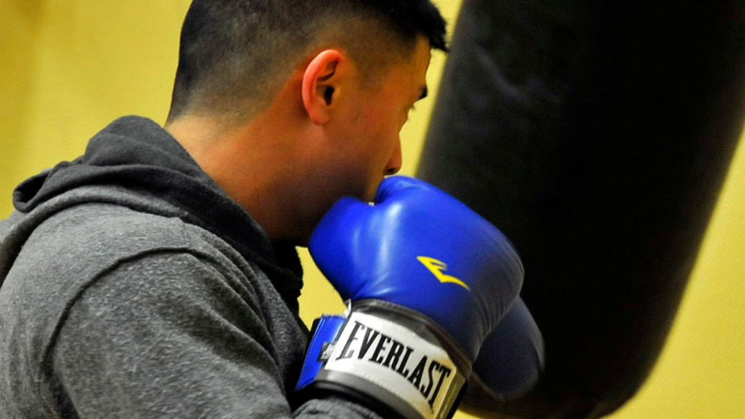
Still
Fighting
Sin?
1 Corinthians 6:9-11
Notes:
This is an important question. Are you still fighting sin?
Consider the brethren at Corinth.
(1 Corinthians 6:9-11), “Do you not know that the unrighteous will not inherit the kingdom of God? Do not be deceived. Neither fornicators, nor idolaters, nor adulterers, nor homosexuals, nor sodomites, ¹⁰ nor thieves, nor covetous, nor drunkards, nor revilers, nor extortioners will inherit the kingdom of God. ¹¹ And such were some of you. But you were washed, but you were sanctified, but you were justified in the name of the Lord Jesus and by the Spirit of our God.”
Imagine what a struggle it was for them to come out of such sins!
We admire such conviction, such resolve, such a change of conduct. This is repentance.
This is the gospel at work in one’s life
(2 Corinthians 7:9-11), “Now I rejoice, not that you were made sorry, but that your sorrow led to repentance. For you were made sorry in a godly manner, that you might suffer loss from us in nothing. ¹⁰ For godly sorrow produces repentance leading to salvation, not to be regretted; but the sorrow of the world produces death. ¹¹ For observe this very thing, that you sorrowed in a godly manner: What diligence it produced in you, what clearing of yourselves, what indignation, what fear, what vehement desire, what zeal, what vindication! In all things you proved yourselves to be clear in this matter.”
Regardless of their continued struggle, and obvious failures, the Corinthians were battling!
And so we ask the question – Are you still fighting sin?
It is important, let’s talk about why.
(Sermon outline based on an article) - Still Fighting Sin? (Steve Wallace) -The Way of Truth and Life (3:22), May 27, 2012

Slide 2
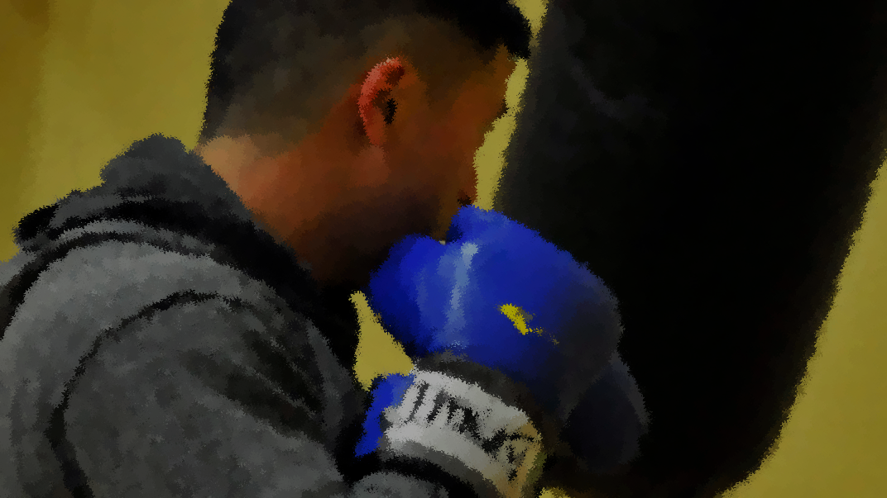
Are You Still Fighting Sin?
The Devil is not finished with YOU!
    1 Peter 5:8-9; James 4:7; cf. Luke 4:13
Temptation will continue to plague us
    2 Corinthians 2:10-11; 1 Corinthians 10:12
There are things we can do to fight it!
    Ephesians 6:10-20; Hebrews 11:1 – 12:2
Notes:
In spite of the past evil he had provoked, the devil was not finished with the Christians at Corinth
There were jealousies present
(1 Corinthians 3:3), “For where there are envy, strife, and divisions among you, are you not carnal and behaving like mere men?”
They were tolerating immorality in their midst
(1 Corinthians 5:1-2), “It is actually reported that there is sexual immorality among you, and such sexual immorality as is not even named among the Gentiles—that a man has his father's wife! ² And you are puffed up, and have not rather mourned, that he who has done this deed might be taken away from among you.”
Some were lacking good sense in the companions they were choosing
(1 Corinthians 15:33), “Do not be deceived: ‘Evil company corrupts good habits.’”
The devil will never be finished with us either!
He may flee when we resist him
(1 Peter 5:8-9), “Be sober, be vigilant; because your adversary the devil walks about like a roaring lion, seeking whom he may devour. ⁹ Resist him, steadfast in the faith, knowing that the same sufferings are experienced by your brotherhood in the world.”
(James 4:7), “Therefore submit to God. Resist the devil and he will flee from you.”
But, he will always come back throughout our lives (As he did with the Lord)
(Luke 4:13), “Now when the devil had ended every temptation, he departed from Him until an opportune time.”
NEXT CLICK
Temptation will continue to plague even the faithful, in some form or fashion. Care must always be taken!
(2 Corinthians 2:10-11) [Paul wrote of the successful discipline of the church in Corinth], “Now whom you forgive anything, I also forgive. For if indeed I have forgiven anything, I have forgiven that one for your sakes in the presence of Christ, ¹¹ lest Satan should take advantage of us; for we are not ignorant of his devices.”
We must be aware, and be humble, lest our arrogance make us vulnerable!
(1 Corinthians 10:12), “Therefore let him who thinks he stands take heed lest he fall.”
NEXT CLICK
There are things we can do to fight SIN!
We can put on the whole armor of God
(Ephesians 6:10-13), “Finally, my brethren, be strong in the Lord and in the power of His might. ¹¹ Put on the whole armor of God, that you may be able to stand against the wiles of the devil. ¹² For we do not wrestle against flesh and blood, but against principalities, against powers, against the rulers of the darkness of this age, against spiritual hosts of wickedness in the heavenly places. ¹³ Therefore take up the whole armor of God, that you may be able to withstand in the evil day, and having done all, to stand.”
Waist girded with truth; Breastplate of righteousness; Shod feet with gospel of peace; Shield of faith; Helmet of Salvation; Sword of the Spirit
We can recall the great cloud of witness that serve as our examples in faithfulness
(Hebrews 12:1-2), “Therefore we also, since we are surrounded by so great a cloud of witnesses, let us lay aside every weight, and the sin which so easily ensnares us, and let us run with endurance the race that is set before us, ² looking unto Jesus, the author and finisher of our faith, who for the joy that was set before Him endured the cross, despising the shame, and has sat down at the right hand of the throne of God.”

Slide 3
Still
Fighting
Sin?
Many faithful Christians in the first century continually fought sin!
You can too!
(Hebrews 4:11)
Notes:
The Corinthians are a good example, as is the apostle Paul himself:
(1 Corinthians 9:26-27), “Therefore I run thus: not with uncertainty. Thus I fight: not as one who beats the air. ²⁷ But I discipline my body and bring it into subjection, lest, when I have preached to others, I myself should become disqualified.”
There are also examples of those who ceased their fight against sin:
Ananias and Sapphira who desired a good reputation, and lied to the Holy Spirit (Acts 5)
Simon the Sorcerer, who quickly turned away from righteousness in the pursuit of power (Acts 8)
The Galatians who quickly turned away from the gospel to a perversion (Galatians 1)
But we, if we so determine, and keep fighting!
The rebellious Israelites did not obtain rest, because of their refusal to trust God
We need to beware, lest the same thing happen to us!
(Hebrews 4:11), “Let us therefore be diligent to enter that rest, lest anyone fall according to the same example of disobedience.”

